Slide 1

Introduction
Book Barter
CSE-5324-002-SFWR ENG I ANLY, DSGN, TESTING
Team Members
Niharika Dandu
Varad Nair
Srujan Chinta
Kushwanth Sai Bollepalli
Sreelakshmi Mopuri
Iteration 2
Team Name: The Fivers | Team Number: 12 11/06/23

Slide 2
Agenda
Introduction
Project Description
Over All Design
Requirements
Use Case List
High Level Use Cases
Use Case Diagram
Requirements to Use Case Traceability Matrix (RUCTM)
Increment Matrix (IM)
Domain Model
Expanded Use Cases/IP
Sequence Diagrams
Design Class Diagram
Code Snippets
Summary

Slide 3

Introduction

Slide 4
Project Description
Users register to establish a personalized reading identity, searching and browsing allows them to locate their next literary adventure.
Messaging facilitates seamless communication and location services make in-person exchanges simple.
Books Rating empowers readers to make informed choices, and safety & privacy features ensure secure interactions.
Wishlist Management guarantees one will never miss a desired read.
In short, "Book Barter" transforms book sharing into a hassle-free, enjoyable experience.

Slide 5
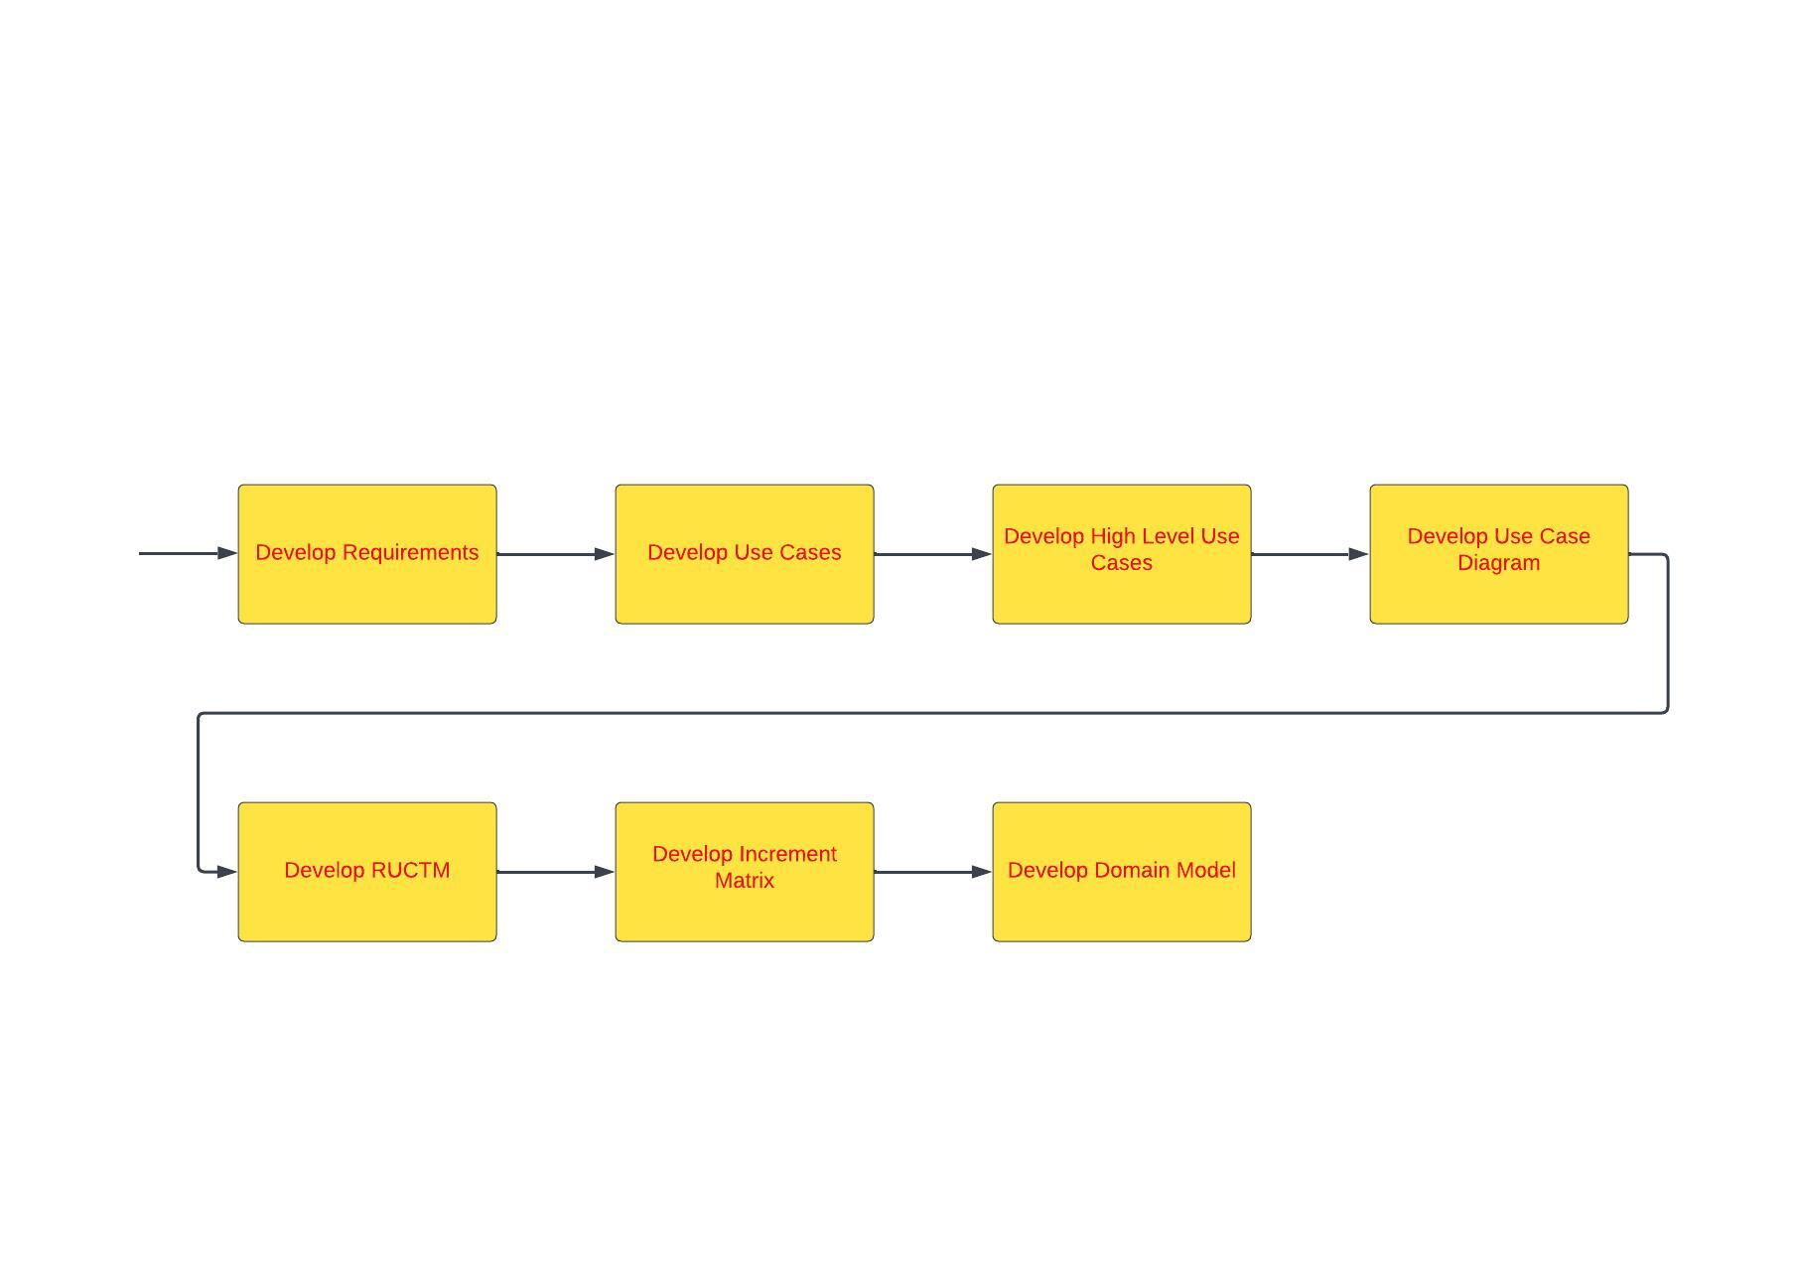
Over All Design Approach

Slide 6
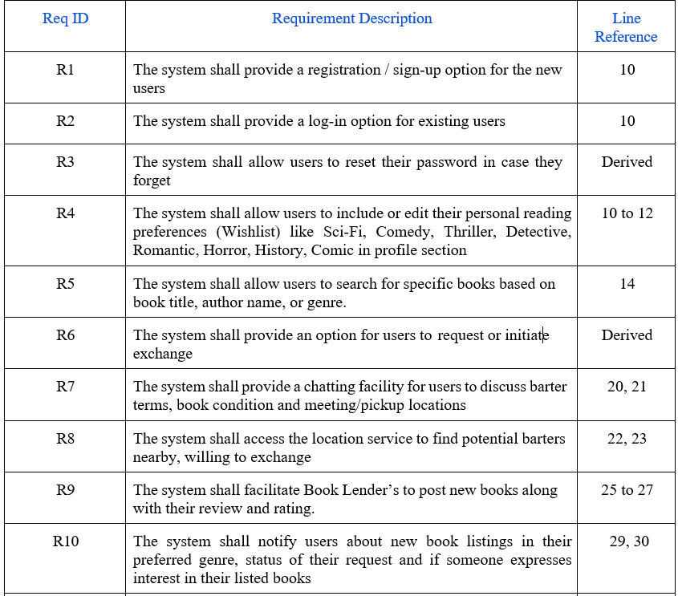
Requirements

Slide 7
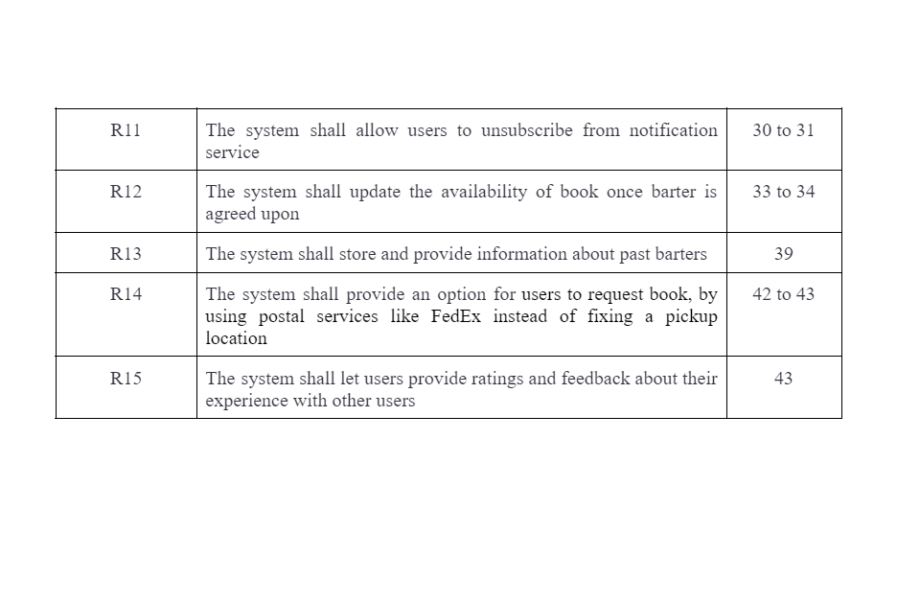
Requirements<<Continued>>

Slide 8
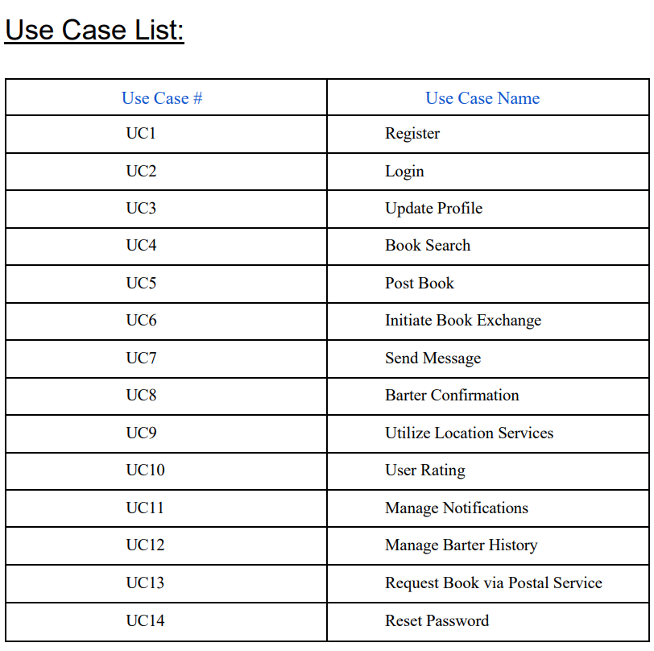

Slide 9
High level Use Cases
UC1: Register
TUCBW user providing registration details (Name, Email, Phone Number, Password) and clicks on Register Button.
TUCEW user being registered
UC2: Login
TUCBW user enters credentials (email, password) and clicks Login button
TUCEW the User gets signed in and the respective screen is displayed (Wishlist selection or Home Screen)
UC3: Update Profile
TUCBW users update their profile information and reading preferences (Wishlist)
TUCEW user profile & wishlist have been updated
UC4: Book Search
TUCBW enabling users to search for specific book titles, authors, or genres
TUCEW list of books that match with the search keyword
UC5: Post Book
TUCBW book lender fills out book name, book author, description, genre and rating along with the book cover picture and submits it
TUCEW book details will be made public along with the ratings

Slide 10
High level Use Cases<<Continued>>
UC 6: Initiate Book Exchange
TUCBW users express their interest in exchanging/receiving a book with another user by scrolling through their feed
TUCEW users decide according to their interest
UC7: Send Message
TUCBW communication between users to discuss book conditions, barter terms, or arrange meetup/pickup details
TUCEW confirmation/denial of book exchange
UC8: Barter Confirmation
TUCBW users confirm the exchange/donation of books and update the status of the book (available or not), ensuring transparency
TUCEW barter confirmation
UC9: Utilize Location Services
TUCBW users can find potential barter nearby, reducing the need for long-distance exchanges
TUCEW finding book barter
UC 10: User Rating
TUCBW users rate other genuine users with feedback after the book is delivered
TUCEW rating the users

Slide 11
High level Use Cases<<Continued>>
UC11: Manage Notifications
TUCBW users customize or control their notifications
TUCEW notifications being customized or turned on/off
UC12: Manage Barter History
TUCBW users keep track of past barters and view their history
TUCEW maintaining barter history
UC13: Request Book via Postal Service
TUCBW users requesting a book using postal services like FedEx
TUCEW book is being delivered
UC14: Reset Password
TUCBW users can enter email for password reset
TUCEW password being updated

Slide 12
Use Case Diagram

Slide 13
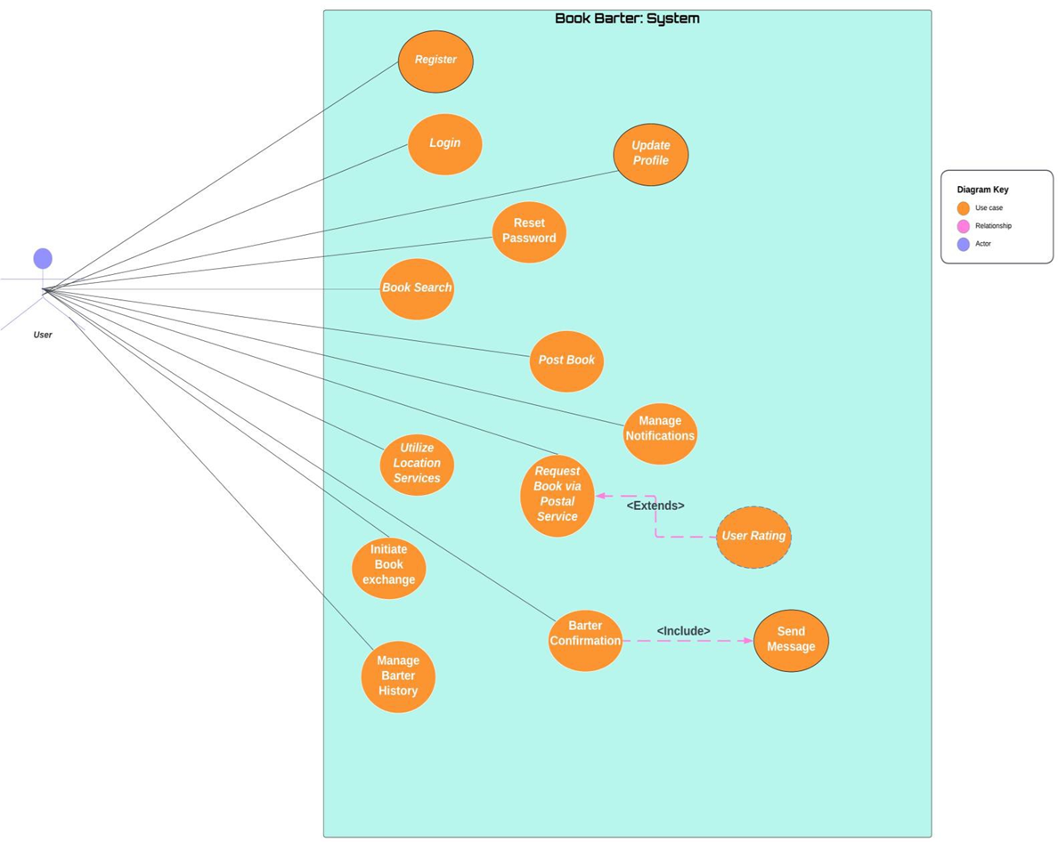

Slide 14
RUCTM

Slide 15
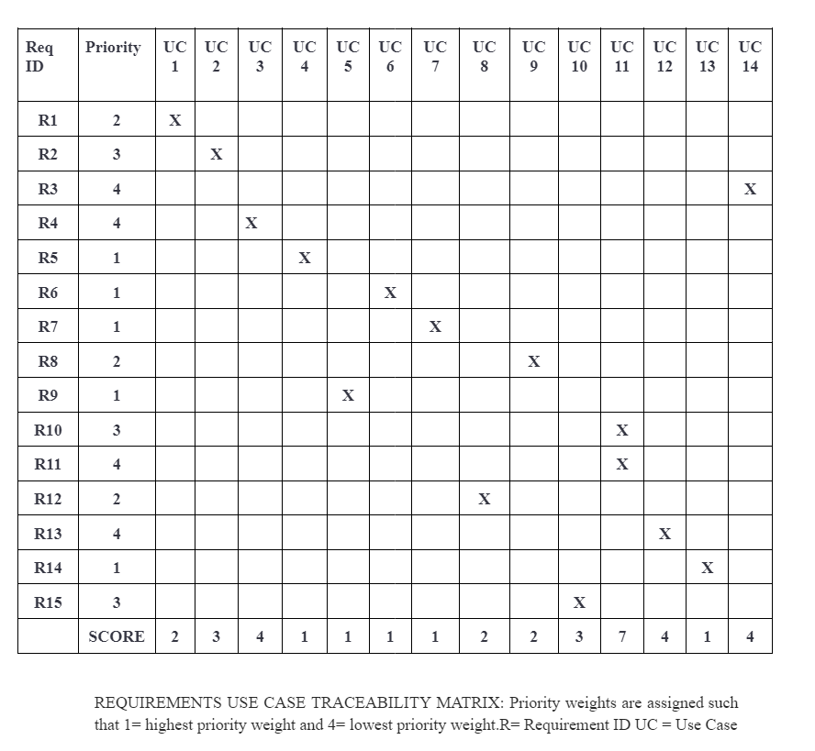

Slide 16
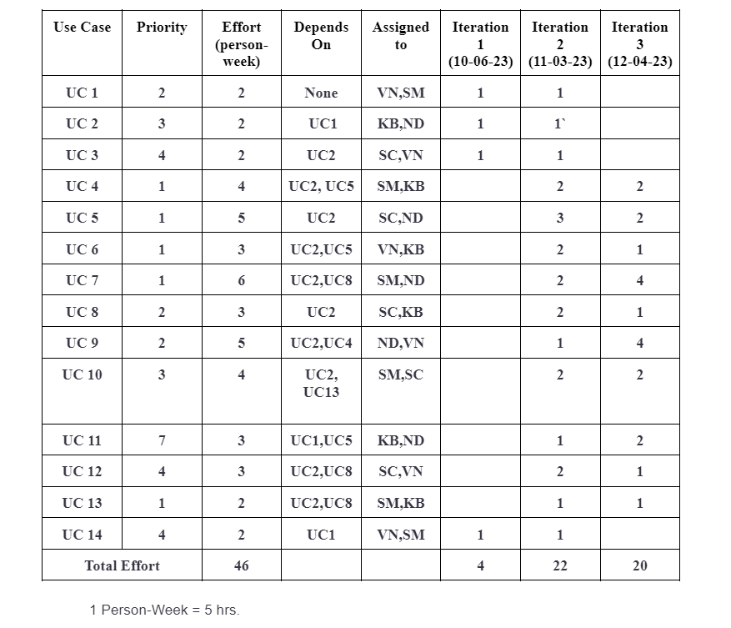
Increment Matrix
Team Members:
VN- Varad Nair
KB- Kushwanth Sai Bollepalli
SC- Srujan Chinta
ND- Niharika Dandu
SM- Sreelakshmi Mopuri
1 Person-Week = 5 hrs.

Slide 17
Domain Model

Slide 18
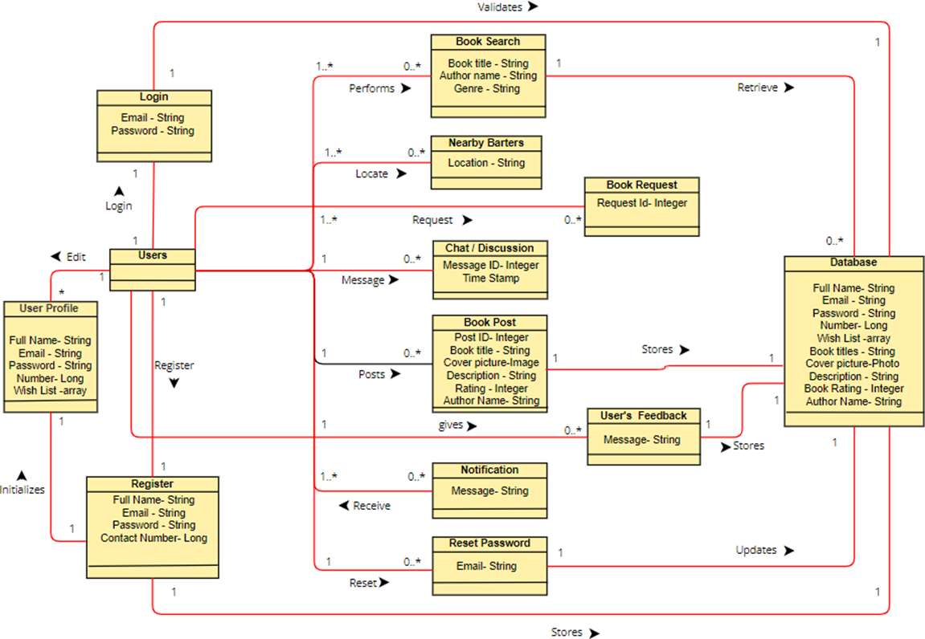

Slide 19
Expanded Use Cases/IP

Slide 20
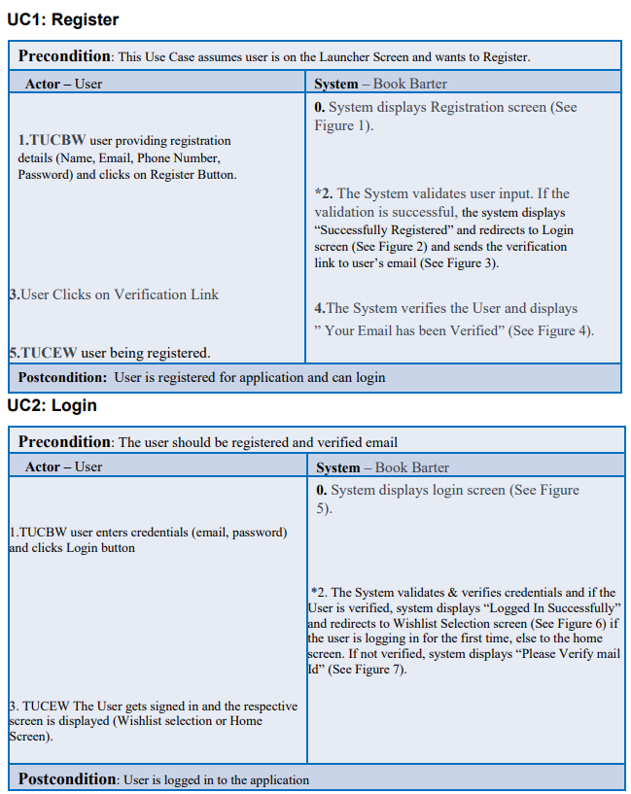

Slide 21
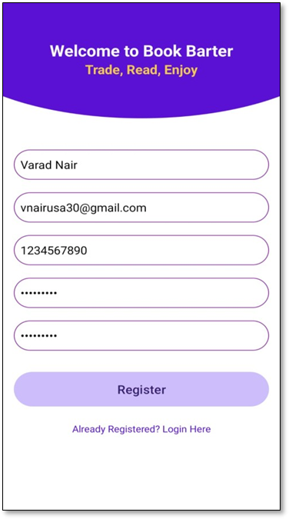
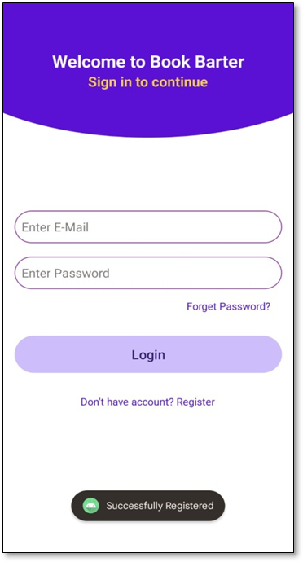
Fig:1
Fig:2

Slide 22
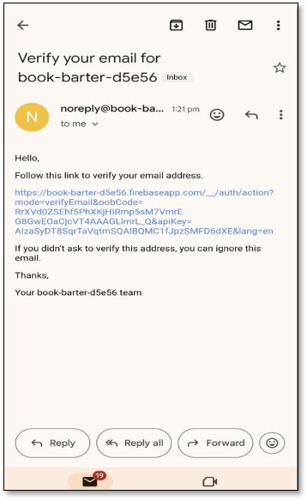

Fig:4
Fig:3

Slide 23
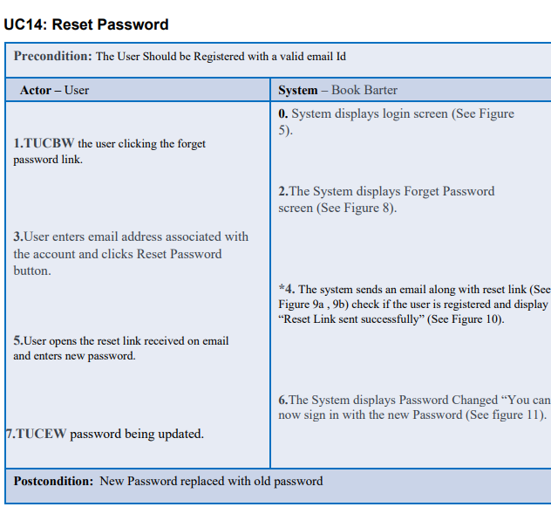

Slide 24
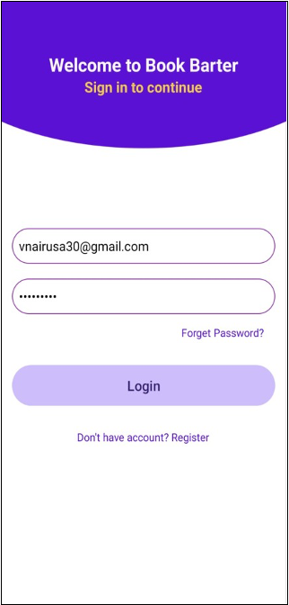
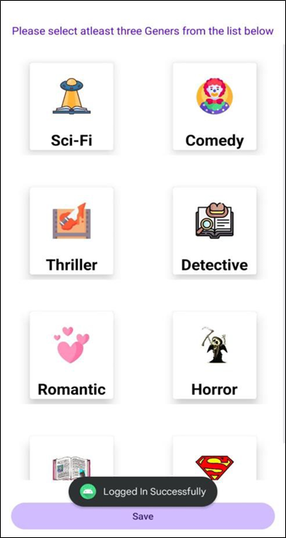
Fig:5
Fig:6

Slide 25
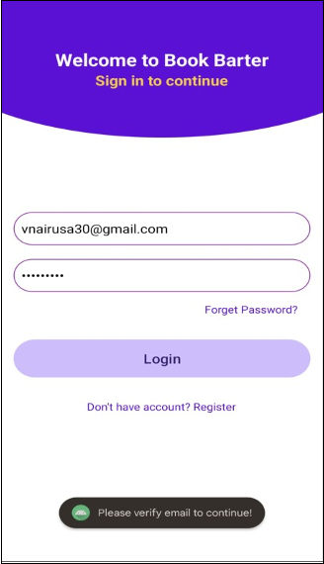
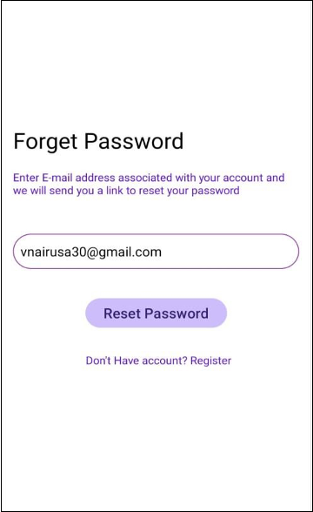
Fig:7
Fig:8

Slide 26
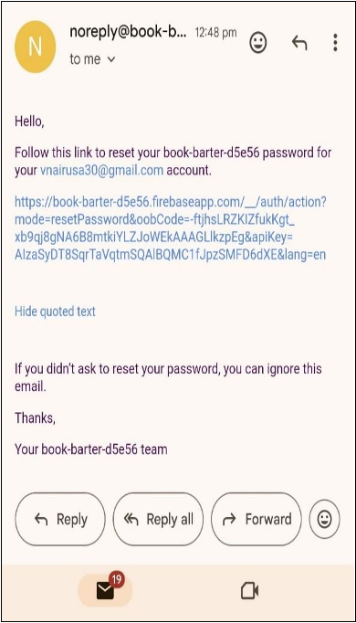

Fig:10
Fig:9

Slide 27
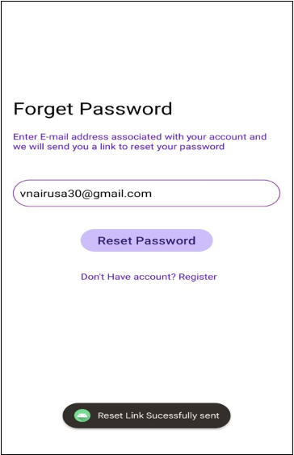

Fig:11
Fig:12

Slide 28
Sequence Diagrams

Slide 29
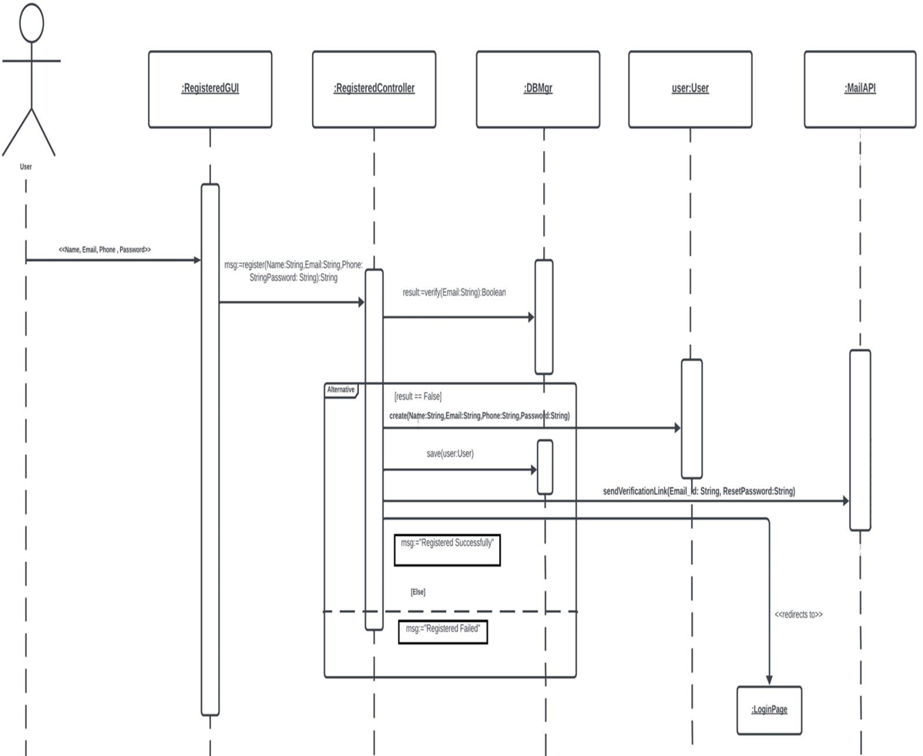
Sequence Diagram For Register:

Slide 30
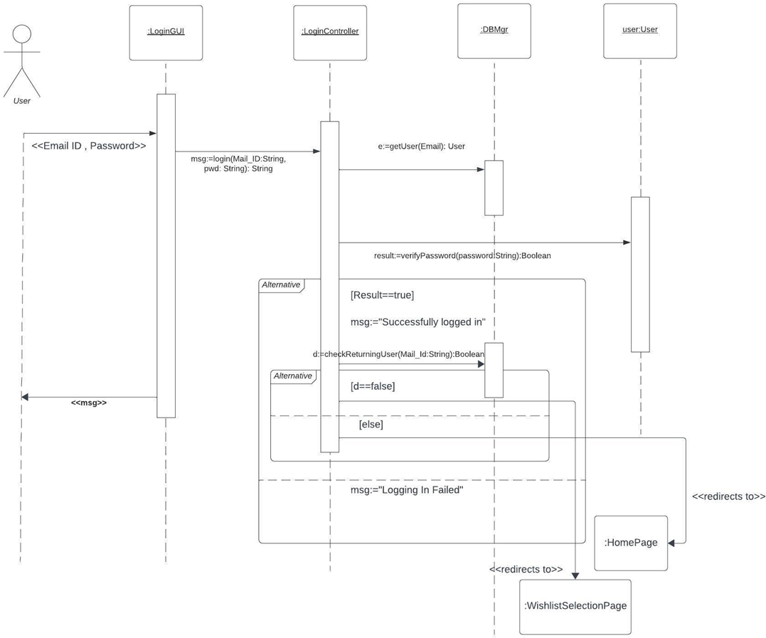
Sequence Diagram For Login:

Slide 31
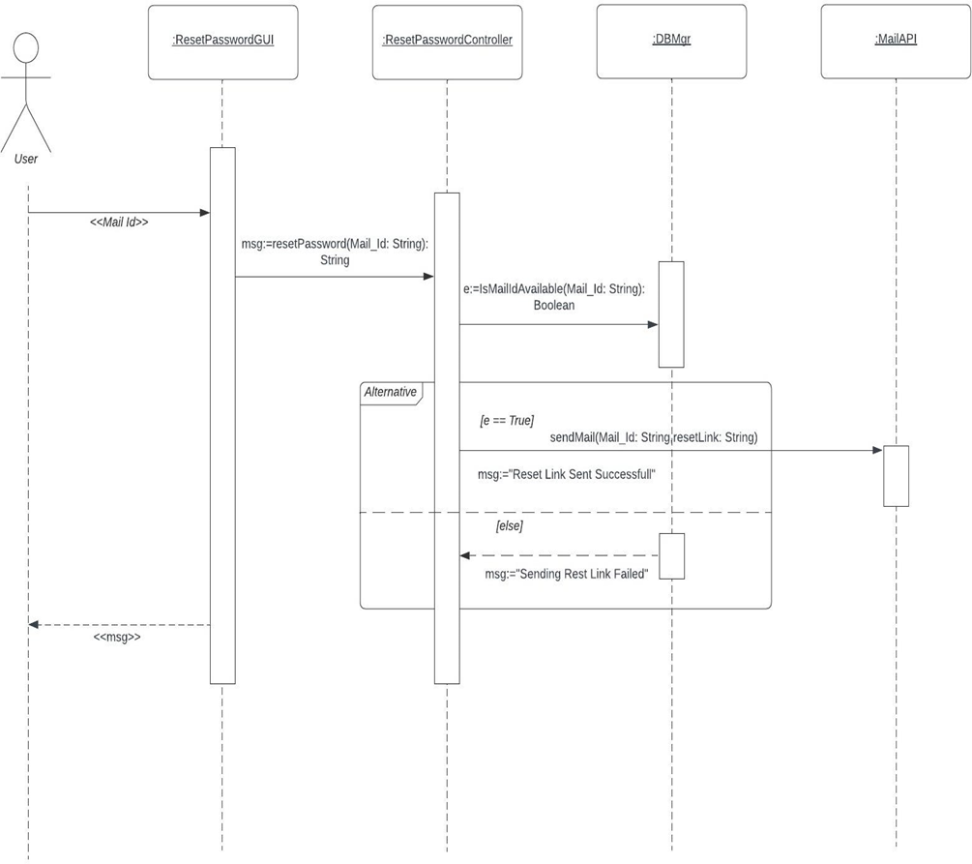
Sequence Diagram For Reset Password:

Slide 32
Design Class Diagram

Slide 33
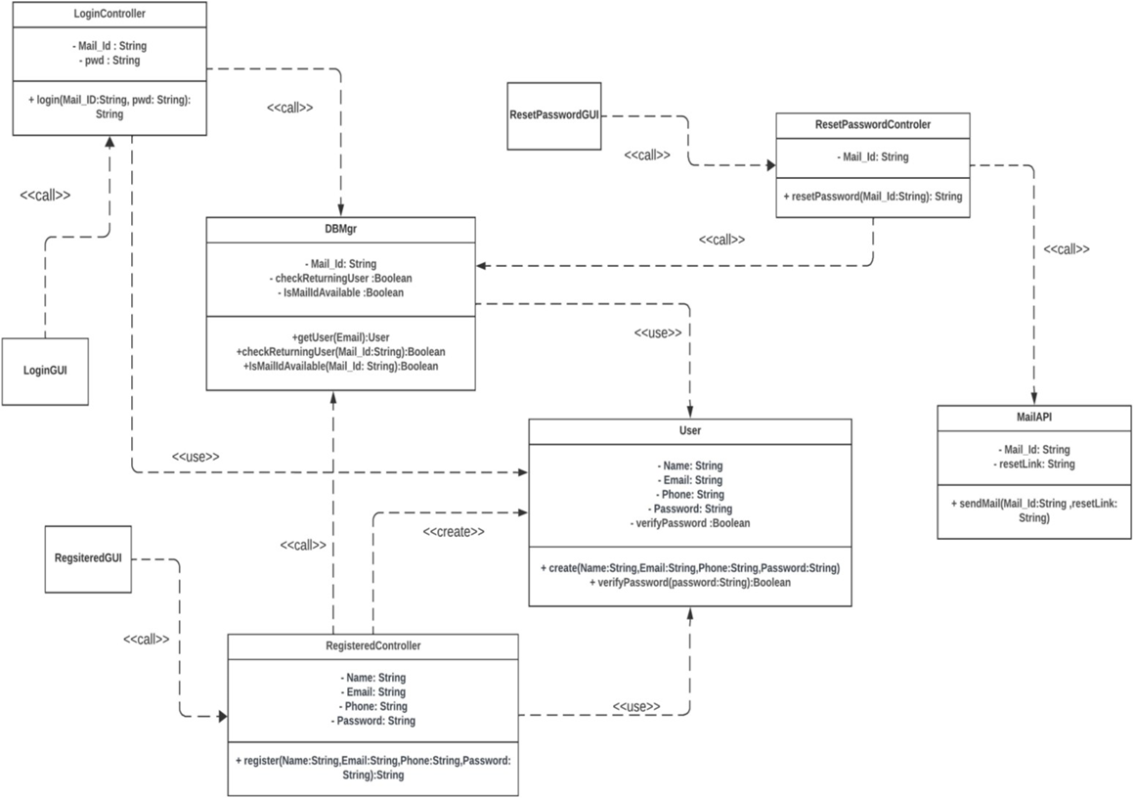

Slide 34
Code Snippets

Slide 35
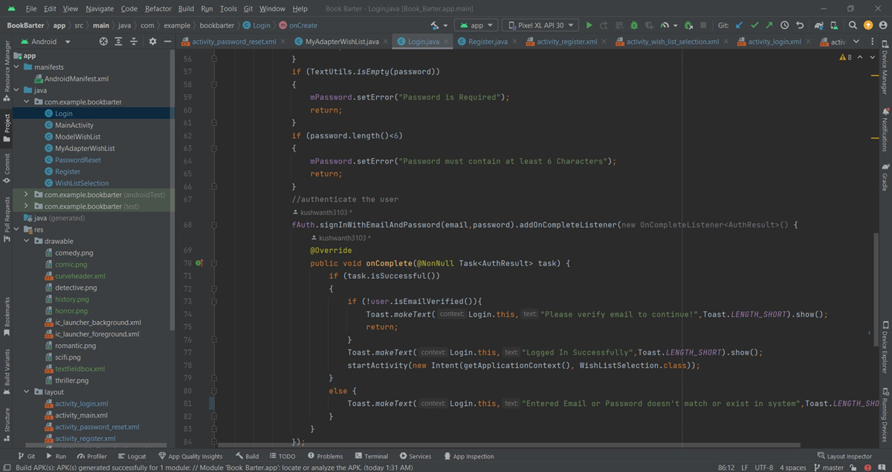

Slide 36
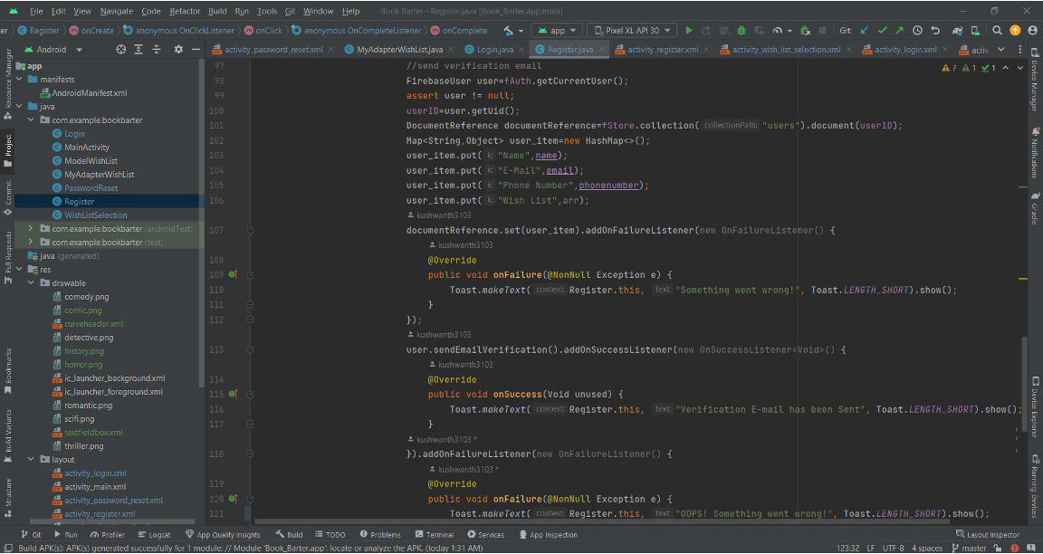

Slide 37
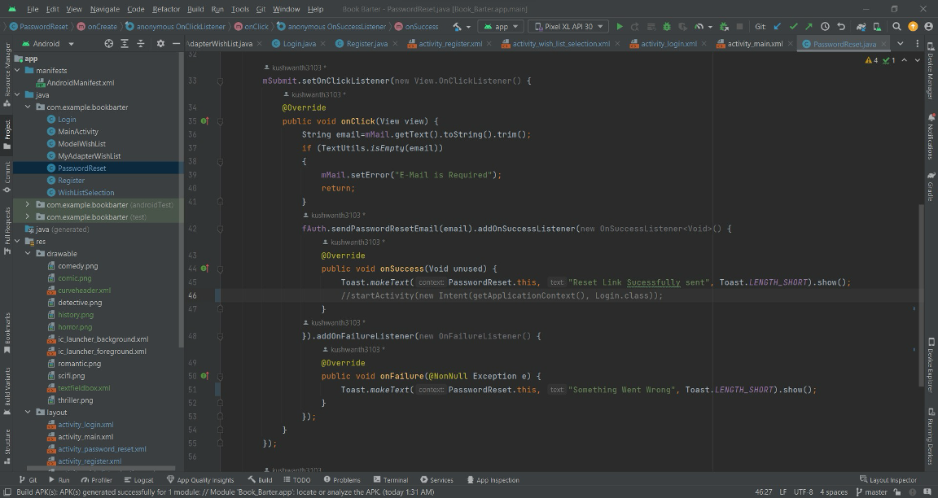

Slide 38
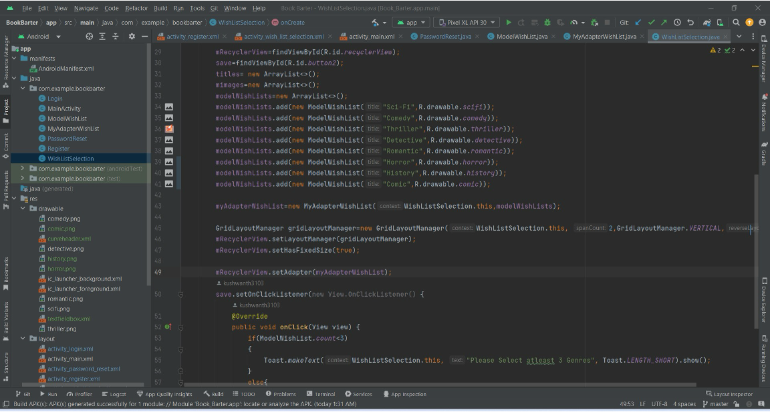

Slide 39
Summary
Effortless Book Discovery
Wishlist Management
Local Book Exchanges
Seamless Communication
Postal Service Integration

Slide 40


